Slide 1
MTE3 on 11.04.2017, Tuesday 9:00-10:15, 10:30-11:45 AM 414W - PAB
Paper based, open book and open electronic devices.
Desirable to have pencils and erasers.
Need logic design handouts 1 – 4 inclusive
Based 70% on LD assignment 1
No requirement to use Logisim simulator and also no restriction to use it.
The next slides show the possible question types of the examination.

Slide 2
Circuit synthesis
The circuit has 4 input variables A, B, C, D and gives logical F=1 on its output when the hexadecimal values of four variables are correspondingly equal to: 0x0 or 0x1 or 0x2 or 0x3 a. Create the truth table of the circuit. (10%) b. Create the formula of the circuit. (10%) c. Minimize the circuit (formula) 1. By Karnaugh map (10%) 2. By Boolean Algebra (show all steps) (20%) d. Create a schematic of the minimized circuit using AND, OR, NOT gates. Use as less amount of gates as possible. (20%) e. Create another schematic where implement the minimized circuit only on 2 input NAND gates. Show all the steps of formula transformation (30%)

Slide 3
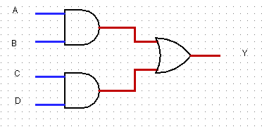
Circuit analyze:
Show a case of the timing diagram with ideal signals where we can see the propagation delay for this circuit.
Y = ab + cd

